Slide 1
SDS Datathon
Student Performance Dataset
Renita Kurian
PES1UG20CS331

Slide 2
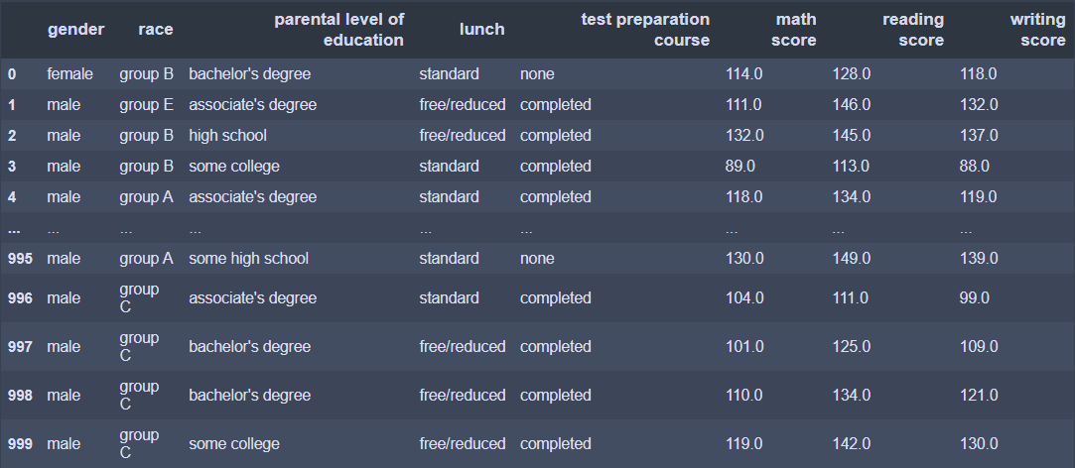
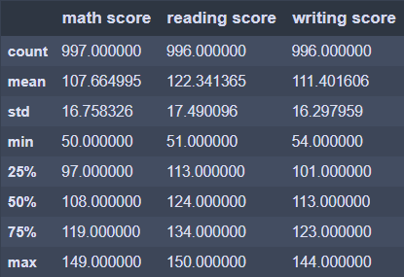
Student Performance Dataset

Slide 3
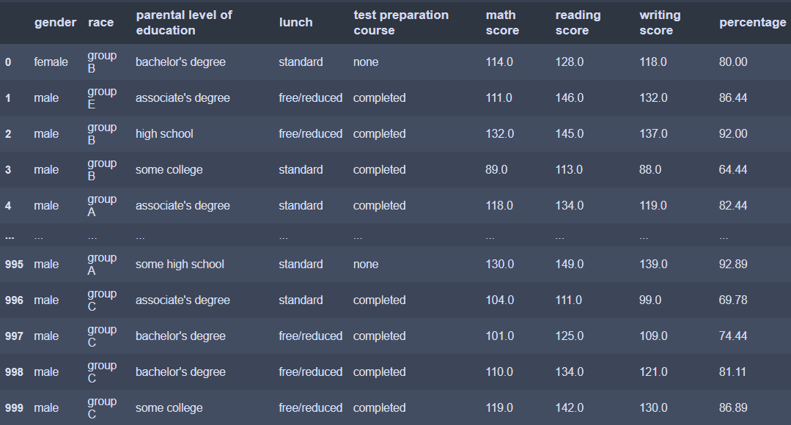
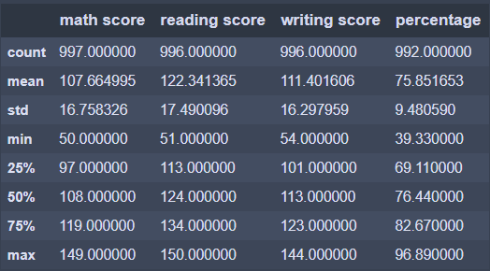
Adding Percentage Column
The percentage of each student is calculated and added to the dataframe. Since the maximum score is taken to be 150, percentage is calculated by –
percentage = (sum of scores /450) *100
It can be seen that that the mean percentage is 75.85%. The max and min percentages are 96.89% and 39.33%.

Slide 4
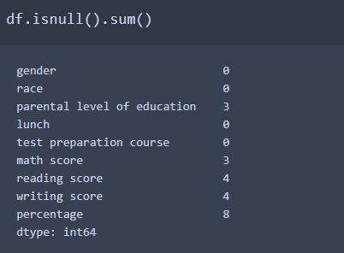
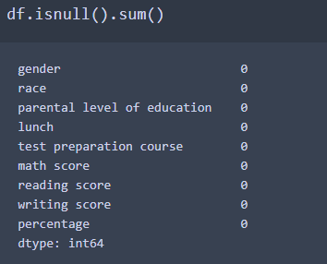
Cleaning the Dataset
Before Data Cleaning
From the given data, it can be seen that the given dataset has 3 null values in parent level of education and 3,4 and 4 null values in math, reading and writing scores. These null values must either be replaced with average value or must be dropped.
After applying the fillna() and dropna() functions the null values are removed.
After Data Cleaning

Slide 5
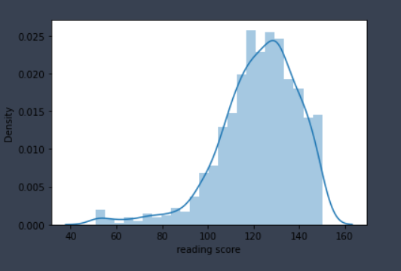
Reading Score Distribution
The reading score distribution is left skewed.
Formula for left skewed:
Skew = 3 * (Mean – Median) / Standard Deviation
Left skewed graphs are also called negatively skewed
Large number of data values occur on the right side with a fewer number of data values on the left side.

Slide 6
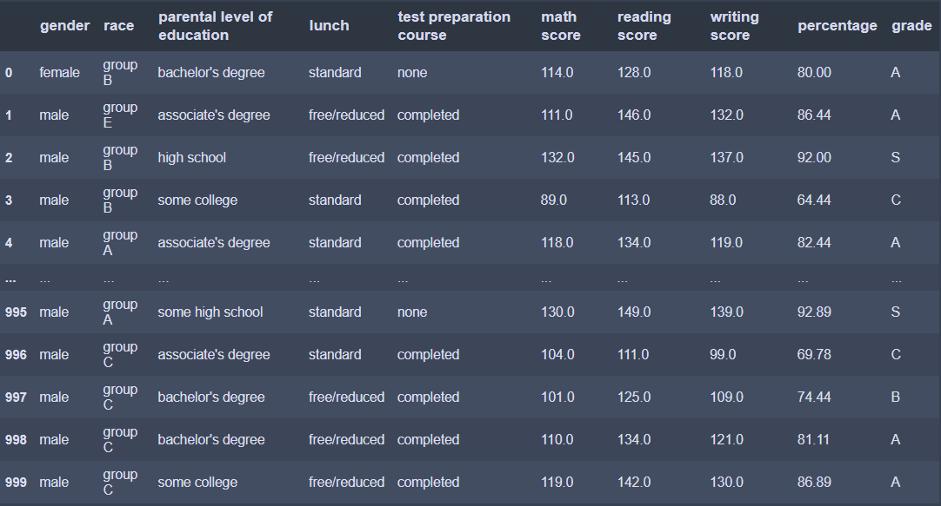
Grades
The students have been assigned grades based on the percentages that have been calculated previously. A student scoring above 90 gets S grade, 80-90 - A, 70-80 gets B and so on. The lowest grade, F, is given to students scoring less than 40. The grades are added to dataframe using map function.

Slide 7
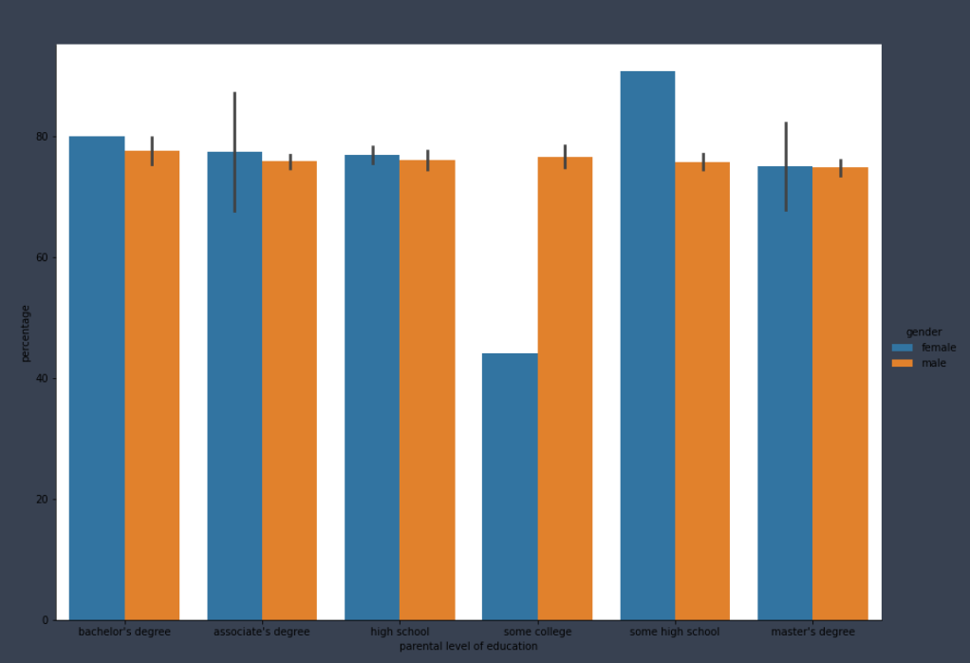
Distribution of Percentage across Parental Level Of Education and Gender
Blue – female
Orange – male

Slide 8
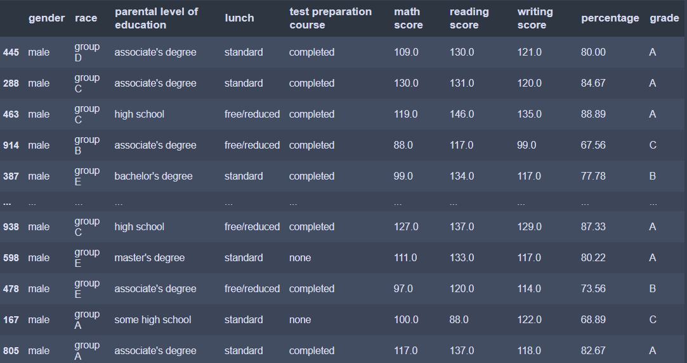
Simple Random Sampling
A random sample is generated

Slide 9
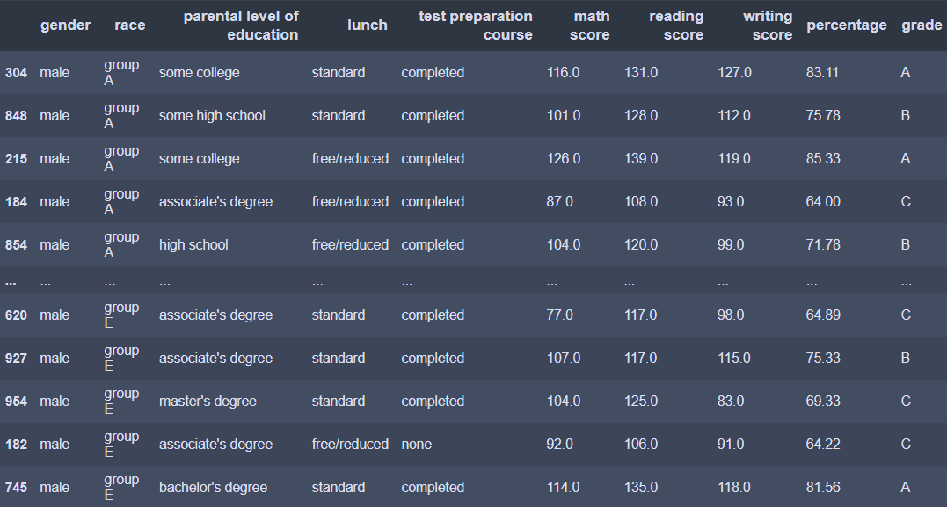
Stratified Random Sampling
This dataset has been generated by stratified sampling. The number of records for each race in sample is in proportion to the population. This has been done by first obtaining 5 different dataframes for each race. Then a random sample is collected from each dataframe. These samples are then merged to get a stratified sample. The groups A,B,C,D and E have 26,20,39,5 and 10 records respectively.

Slide 10
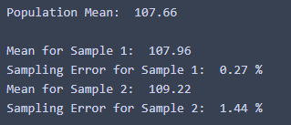
Sampling Means and Errors
The sample means for math scores for a and b are 107.96 and 109.22. The mean for population was calculated to be 107.66. The sampling error for a and b are 0.27% and 1.44%. Hence, a is a better sample than b since it has a lower sampling error.

Slide 11
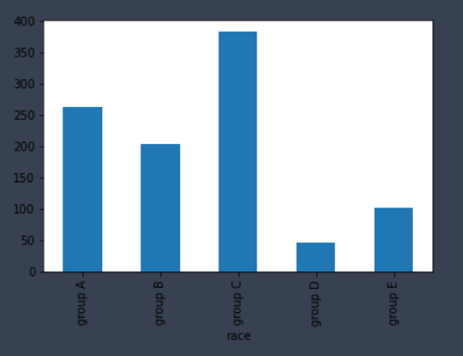
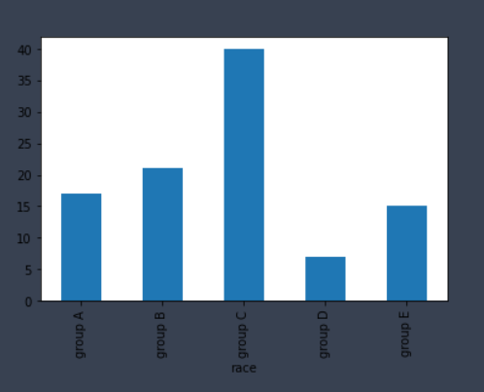
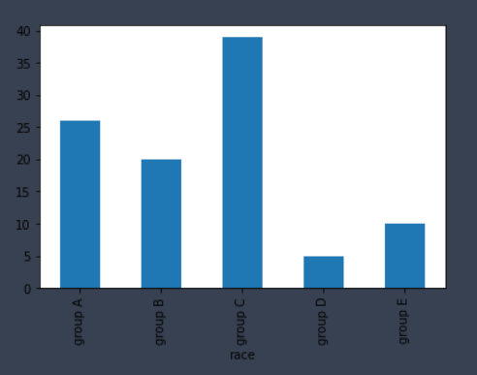
Race Distribution
The given bar charts show the distribution of race in population and samples a and b. It can be seen that the distribution of race is similar in sample b and population and varies slightly in sample a. However, from the data calculated in previous steps sample a has a lower error compared to b and is hence a better sample. It can thus be inferred that race does not play a significant role in student perfomance.
Population
Sample a
Sample b

Slide 12
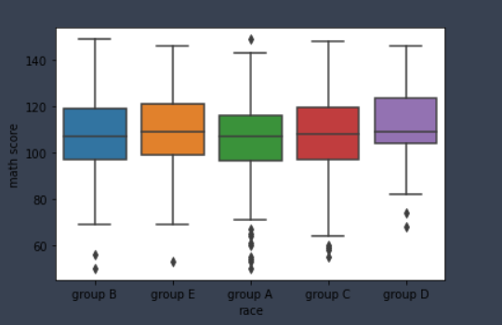
Math Score Boxplot
Group A has the highest number of outliers

Slide 13
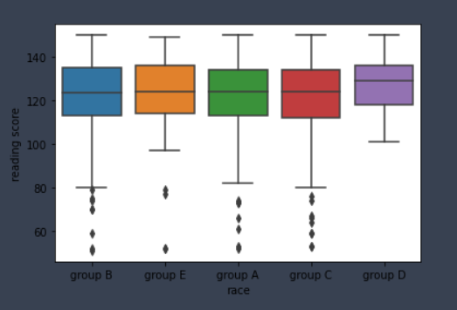
Reading Score Boxplot
It is seen that Group C has the highest number of outliers. Group A and B also has a lot of outlier values

Slide 14
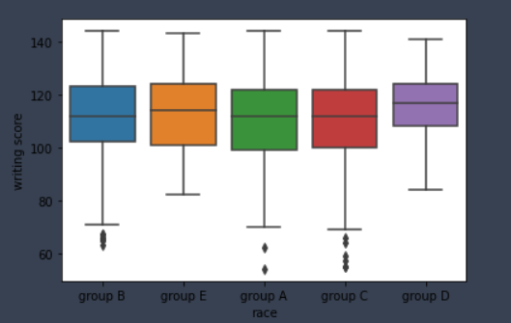
Writing Score Boxplot
Group C has the highest number of outliers

